Slide 1
Data Mining: Probability and Statistics
Tom Heskes

Slide 2
Probability and Statistics
probability
statistics
hypothesis testing
Note: see Appendix C of TSK

Slide 3





Probabilistic reasoning
Logic
hard for machines
Uncertainty

Slide 4

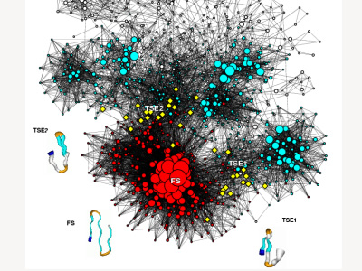
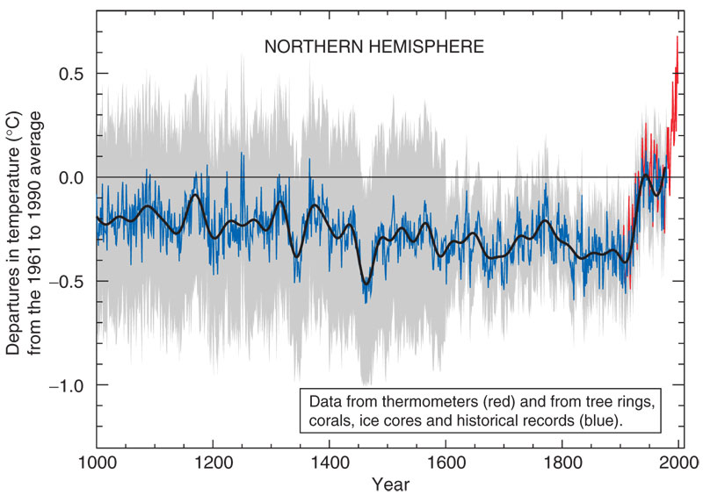
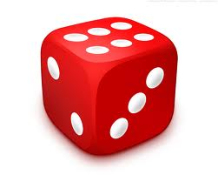
Probabilistic reasoning
Logic
Uncertainty

Slide 5
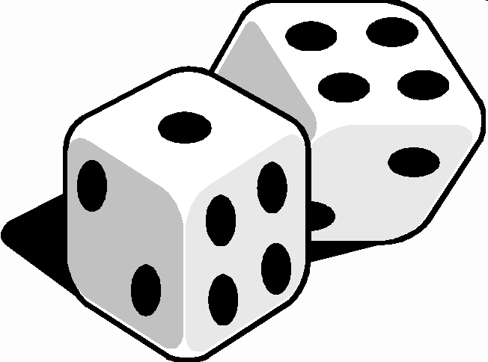
Concepts
Random experiment
rolling a die, flipping a coin, monitoring network traffic
Sample space, all possible (single) outcomes:
Ω = {1,2,3,4,5,6} for rolling a die
Ω = {heads,tails} for flipping a coin
Ω = [0,+∞) for number of collisions per hour
Event E is a subset of these outcomes:
E = {2,4,6} observing an even number

Slide 6
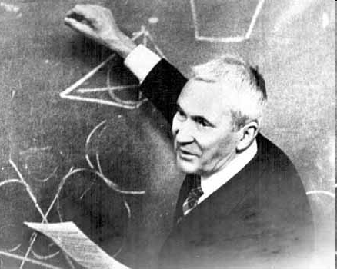
Probability
A probability is a real-valued function define on the sample space Ω.
Probabilities are between 0 and 1:
The probability of everything equals 1:
Probabilities over disjoint events add:

Slide 7
Random variable
Quantity of interest related to a random experiment
number of heads when flipping a coin 30 times
time required to get back home
Probability distribution (aka probability mass function) for a discrete random variable:

Slide 8
Probability distribution (example)
A fair die is rolled 4 times
X is number of times the outcome is 3 or higher
Possible outcomes: 6⁴=1296
Possible values for X are 0,1,2,3,4
X | 0 | 1 | 2 | 3 | 4
P(X) | (1/3)⁴ =1/81 | 4(1/3)³(2/3) =8/81 | 6(1/3)²(2/3)² =24/81 | 4(1/3)(2/3)³ =32/81 | (2/3)⁴ =16/81

Slide 9
Probability density function
For continuous variables:
f(x) is called a probability density function
Probability that X takes a particular value is zero!
Questions:
Can f(x) be negative?
Can f(x) be larger than 1?

Slide 10

Distribution plushies

Slide 11
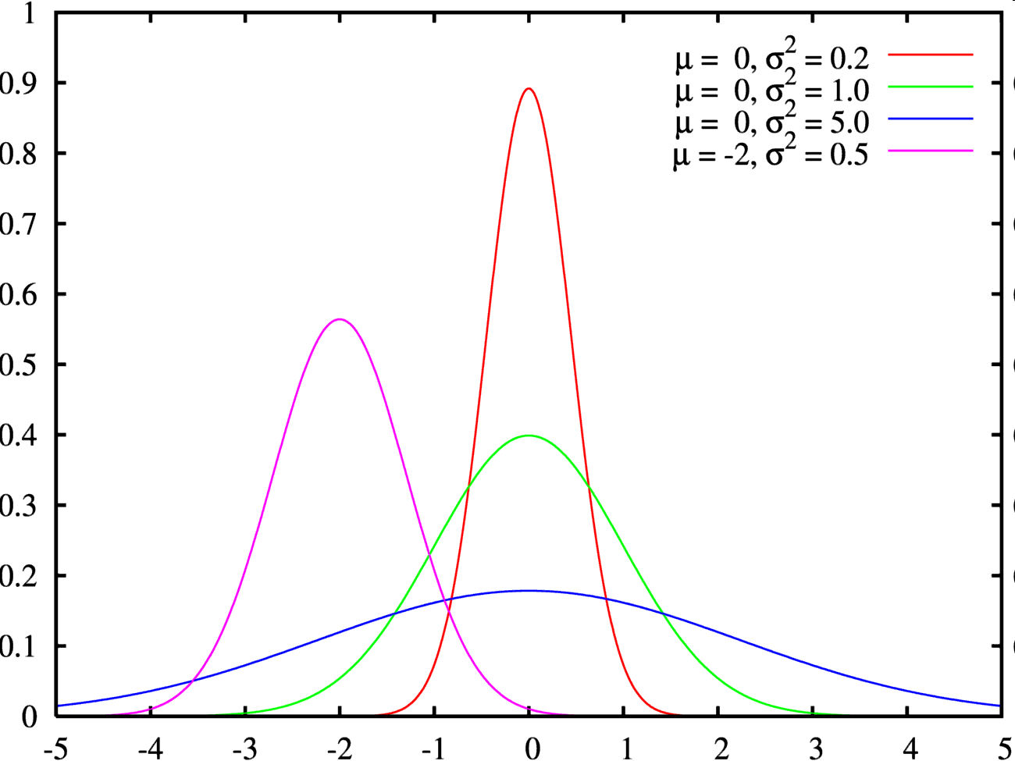
Gaussian distribution
Applicable in many fields due to central limit theorem
sum of many random variables is Gaussian
‘error/noise model’
Location parameter (mean) μ and spread (standard deviation) σ
‘standard
normal’

Slide 12
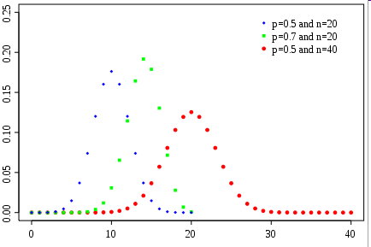
Binomial distribution
Number of successes in a number of independent yes/no trials
tossing a coin many times
nr. of ‘six-throws’ in a game of dice
Number of trials n and probability of success p

Slide 13
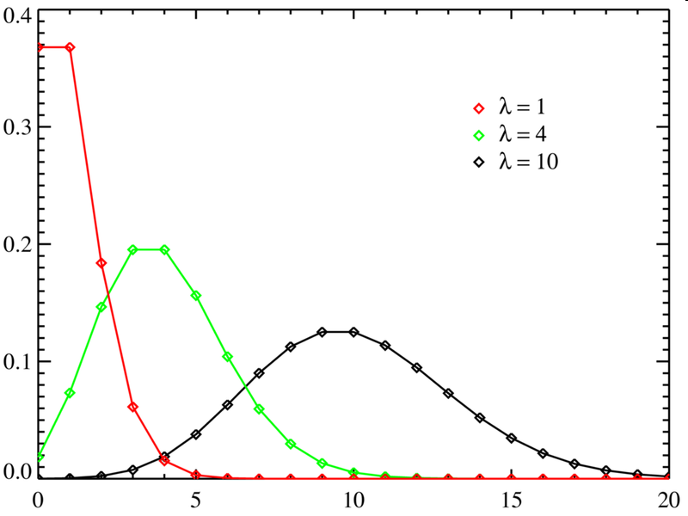
Poisson distribution
Probability of number of events occurring in a fixed period of time/space,
nr. of people entering the building per hour
nr. of hedgehogs killed per km of road
nr. of mutations per 100.000 base pairs
typically ‘rare events’
Rate parameter λ

Slide 14
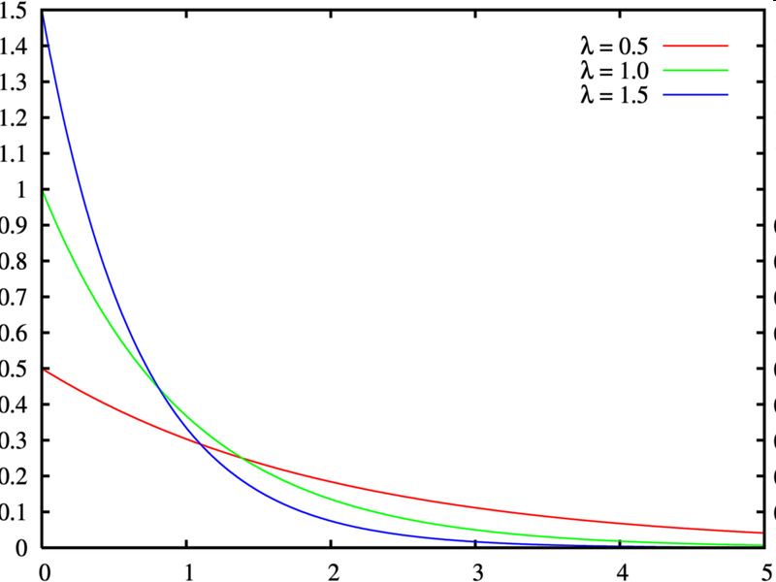
Exponential distribution
Probability density of times between events, e.g.,
time it takes before the next person enters the building
time between hits on a website
‘Memoryless’
Rate parameter λ

Slide 15
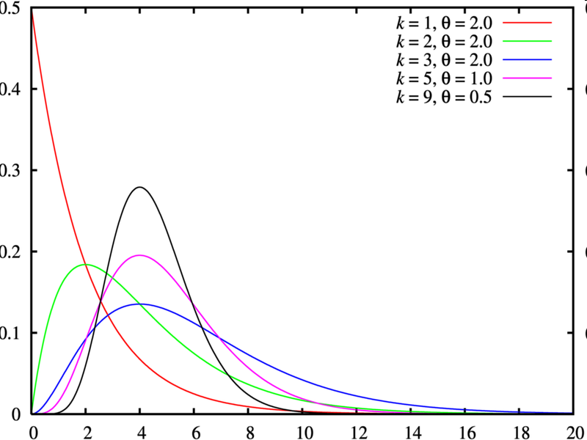
Gamma distribution
“Gaussian” for only positive values,
distribution of incomes
lifetime of light bulbs
Scale parameter θ and shape parameter k

Slide 16
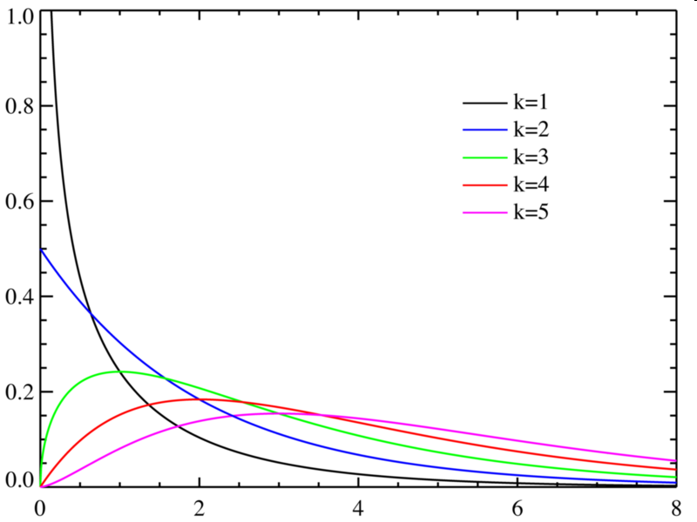
Chi-square distribution
Often used in statistical significance tests
Special case of Gamma distribution (with θ → 2, k → k/2)
Degrees of freedom k: (distribution of sum of the squares of k normally distributed random variables)

Slide 17

Tails matter …
Cauchy distribution
looks like a ‘fat tailed’ Gaussian …
… but has no mean(!), no variance
and very insensitive to outliers
Location parameter μ and scale parameter γ

Slide 18
Multiple random variables
If X and Y are two random variables, then P(X,Y) is their joint probability distribution
If the random variables are independent, we have
Example: Throwing a fair die
X: outcome of die is ‘3’ or higher;
Y: even outcome
⇒ Are X and Y independent?
P(X) = P({3,4,5,6}) = 2/3,
P(Y) = P({2,4,6}) =1/2,
P(X,Y) = P({4,6}) = 1/3 = P(X) P(Y), …. so yes: independent

Slide 19
Conditional probability
Definition:
Probability of Y “given” X
Example: Throwing a fair die
X: outcome of die is ‘3’ or higher;
Y: even outcome
⇒ What is P(Y|X)?
direct: P(Y|X) = P({4,6} | {3,4,5,6}) = ½
formula: P(Y|X) = (P(X,Y) = ⅓) / (P(X) = ⅔) = ½

Slide 20
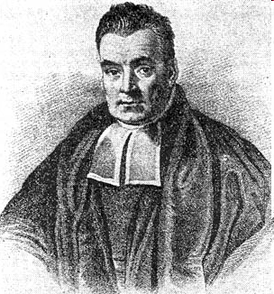
Bayes’ theorem
From
and
we have
Using Bayes’ rule we can invert the probability of effect given cause to the probability of cause given effect: probabilistic reasoning
X
?
Y

Slide 21
Expected value (discrete)
The expected value of a function g of a discrete random variable X:
Example:
If you throw outcome k, you receive k² euros
What is your expected pay-off for a fair die?

Slide 22
Expected value (continuous)
The expected value of a function g of a continuous random variable X:
Example:
X homogeneously distributed between 0 and 1
What is E[x²]?

Slide 23
Common expected values
Mean value:
Variance:
Covariance:

Slide 24
Expectation ‘paradoxes’
Devil’s wager:
you are accidentally and unexpectedly sent to hell, where Old Harry makes you an offer:
toss a fair coin → heads you’re free, tails you stay … forever, or
wait one day in hell → then get the same offer but with half the chance to loose the bet
… so the optimal solution is to never leave?
Two envelopes problem:
one envelop contains twice as much money as the other, you get to choose
you want to pick A … but what if you switch to B?
… and back again? And again?

Slide 25
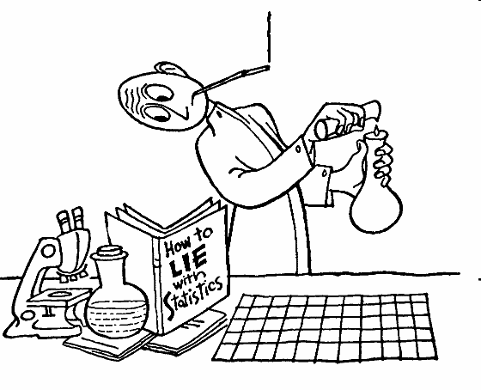
Statistics
“Inverse” probability theory
Probability: given the rules of probability theory, compute probabilities and expected values of interest given a particular probability model
Statistics: given a finite set of data (and assuming some underlying probability model), estimate the parameters of the model

Slide 26
Point estimation
Model: N samples X_{i} are drawn from some probability density with (unknown) mean μ_{X} and variance σ_{X}²
Given data, what’s our best estimate for μ_{X} and σ_{X}²?
Obvious choices:
sample mean
sample variance

Slide 27
Unbiased estimator
Thought experiment: repeat the previous many times, i.e.
generate N samples X_{i} from some probability density with mean μ_{X} and variance σ_{X}²
compute the resulting sample mean and sample variance
Check whether, on average, the answer is correct
Easy to check for the sample mean:

Slide 28
Sample variance (1)
this is where it happens…
this is where it happens…

Slide 29
Sample variance (2)
From previous slide:
From definitions and independent samples:
And thus:

Slide 30
Standard error of the mean
Using similar calculations, it can be shown that
Substitute the estimate s_{X} for the (unknown) σ_{X}
is called the standard error of the mean

Slide 31
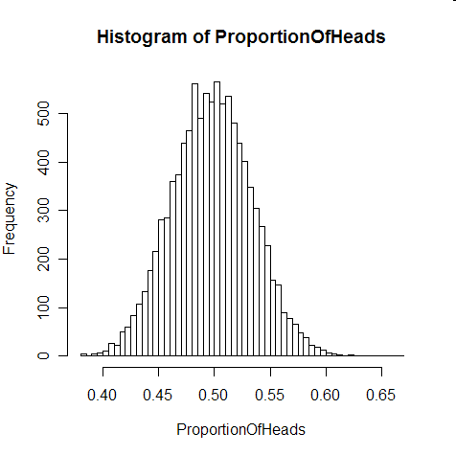
Central limit theorem
Consider the sample mean of N samples from some distribution with mean μ_{X} and variance σ_{X}²
For large N, the distribution of the sample mean approaches a Gaussian with mean μ_{X} and variance σ_{X}²/N
This is independent of the underlying distribution of the samples!

Slide 32
Interval estimation
We’d like to say a bit more than just our best guess
Next best: mention the standard error
Even better: give a confidence interval
(θ₁,θ₂ ) is the confidence interval for θ at the confidence level α

Slide 33
Interpretations of confidence interval
“Were this procedure to be repeated on multiple samples, the calculated confidence interval (which would differ for each sample) would encompass the true population parameter 90% of the time”
“The confidence interval for α=0.1 represents values for the population parameter for which the difference between the parameter and the observed estimate is not statistically significant at the 10% level”

Slide 34
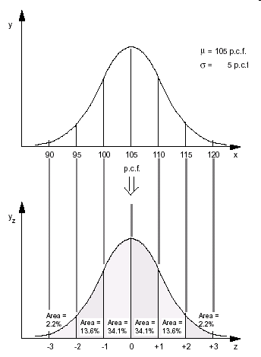
Confidence interval for sample mean (1)
Central limit theorem: the distribution of the population mean approaches a normal distribution with mean μ_{X} and variance σ_{X}²/N
That is, the variable has a standard normal distribution (mean 0, variance 1):

Slide 35
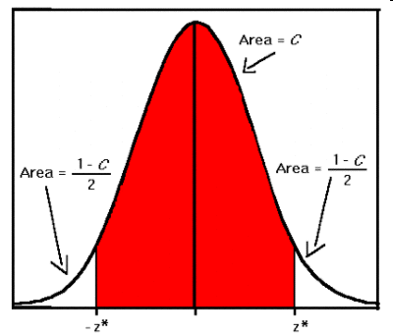
Confidence interval for sample mean (2)
“Inverting” this, if we observe a sample mean , the confidence interval for μ_{X} reads
We typically don’t know σ_{X} and then substitute our best estimate s_{X}

Slide 36

Hypothesis testing
Should we accept or reject a hypothesis (e.g., ‘men are taller than women’) given the data available?
Typical question in data mining: is one method or model significantly better than another?
Results are often only publishable if they show a significant improvement at significance level α=0.05

Slide 37
Confirmatory data analysis
Assuming that the null hypothesis is true, what is the probability of observing a value for the test statistic that is at least as extreme as the value that was actually observed?
Null hypothesis:
coin/die is fair,
no difference between classification methods,
random variables X and Y are independent, …
Test statistic:
number of heads,
difference between performance scores,
chi-squared statistic as normalized sum of squared difference between observed and expected frequencies under the null hypothesis, …

Slide 38
Procedure
Formulate the null (“simple”) hypothesis
Define a significance level α
Define a test statistic θ with a known probability distribution under the null hypothesis
Compute θ* as the value of θ from the observed data
Compute the p-value: the probability of θ under the null hypothesis at least as extreme as the observed value θ*
Reject the null hypothesis if the p-value is smaller than the significance level α

Slide 39
In terms of confidence intervals
Formulate the null (“simple”) hypothesis
Define a significance level α
Define a test statistic θ with a known probability distribution under the null hypothesis
Compute the value of θ from the observed data
Compute the confidence interval for θ under the null hypothesis for confidence level α
Reject the null hypothesis if the observed value θ* is outside the confidence interval

Slide 40

Example: fair coin (1)
Null hypothesis: our coin is fair
Choose significance level, e.g. α=0.05
Observed data: N=100 throws, 60 heads, 40 tails
Enough evidence to reject the null hypothesis?

Slide 41
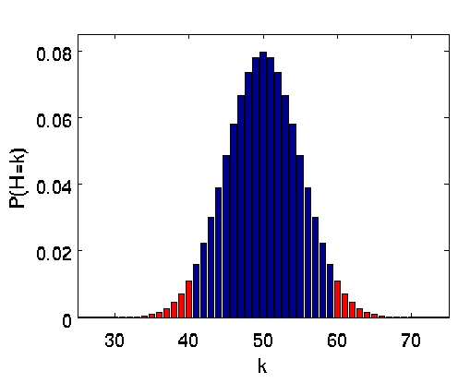
Example: fair coin (2)
Test statistic: H = number of heads
Observed: H*=60
Probability distribution of H under null hypothesis: binomial distribution
p-value (red area): 0.057, i.e., not significant at 0.05 level: no (not enough) reason to reject the null hypothesis
less extreme than observed
at least as extreme as observed

Slide 42
One-sided versus two-sided tests
One-sided:
“better/larger/heavier than”
consider only one of the tails to compute p-value
Two-sided:
“different from”
consider both tails to compute p-value
(or consider one tail, but then divide the significance level by 2)

Slide 43

Publication bias and p-value hunting
Results that are not statistically significant are still hard to publish…
Publication bias
P-value hunting

Slide 44
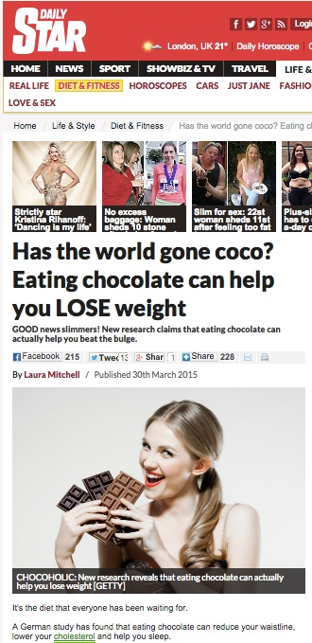
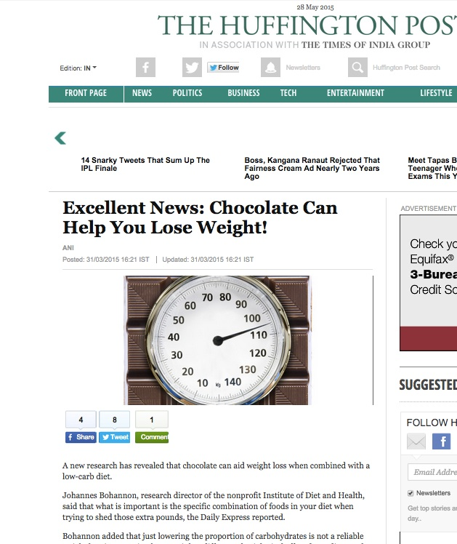


Chocolate accelerates weight loss
http://io9.com/i-fooled-millions-into-thinking-chocolate-helps-weight-1707251800

Slide 45
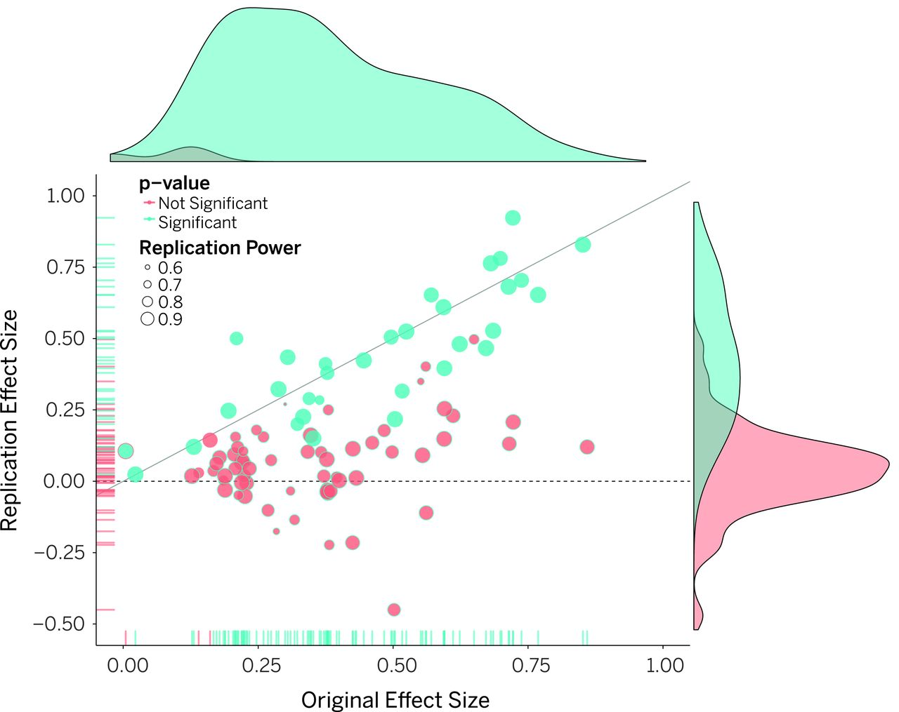

Reproducibility of psychological science
Original study effect size versus replication effect size (correlation coefficients).
Open Science Collaboration Science 2015;349:aac4716
Published by AAAS
Notes:
Original study effect size versus replication effect size (correlation coefficients). Diagonal line represents replication effect size equal to original effect size. Dotted line represents replication effect size of 0. Points below the dotted line were effects in the opposite direction of the original. Density plots are separated by significant (blue) and nonsignificant (red) effects.

Slide 46
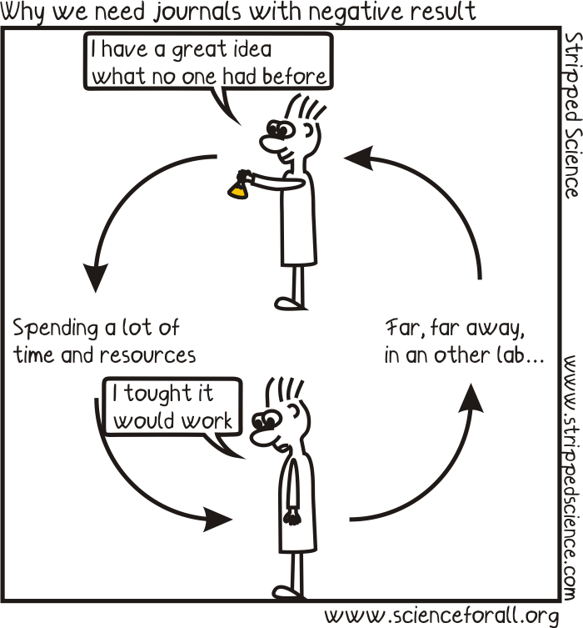


Publishing negative results

